Slide 1
Basics of Python (Part 1)
Prof. Yong Won SEO, Ph.D.
College of Business and Economics
Chung-Ang University

Slide 2
Installation
Basics of Python

Slide 3
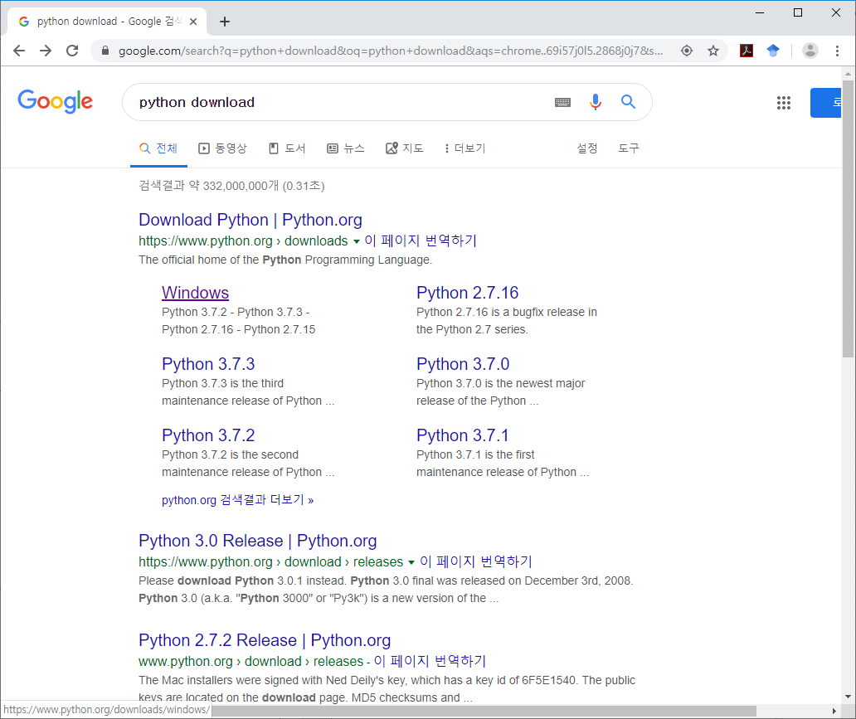

Slide 4
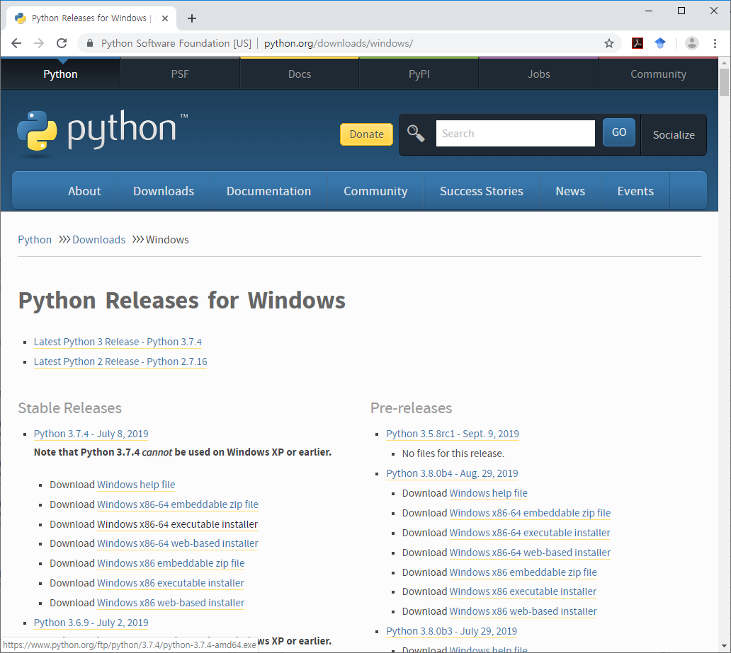
Mostly this for Windows 10
Or, if you use 32bit Windows OS (rare case)

Slide 5
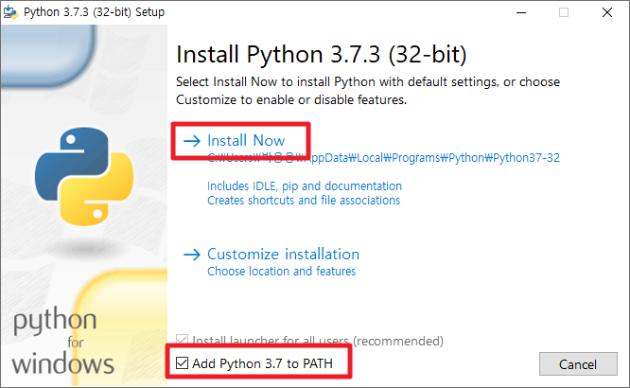
4 (64-bit)
-64

Slide 6
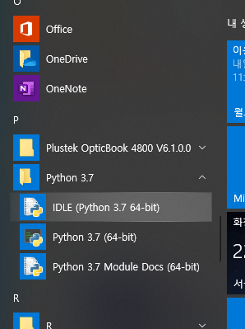

Slide 7
shell command
Basics of Python

Slide 8
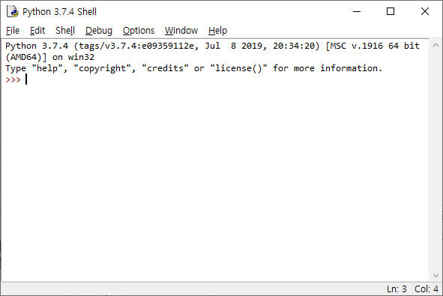
Terminology
Prompt
Cursor
Shell (or Console)
Command
Try
Arithmetic commands
Basic python commands such as
print(“Hello world!”)

Slide 9
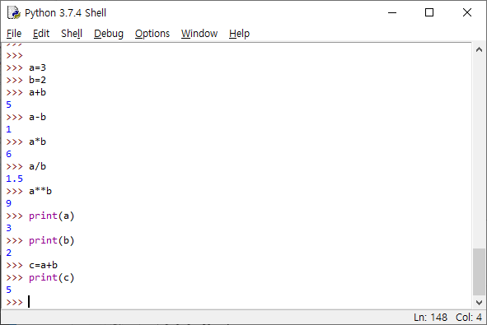
Variables

Slide 10
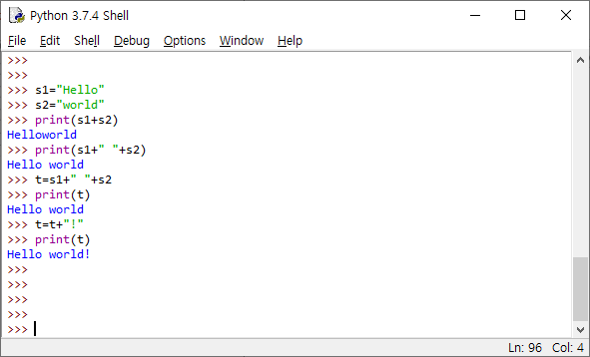
Variables may contain various types

Slide 11
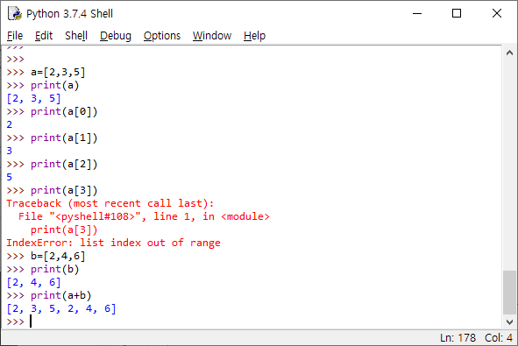
List

Slide 12
my first python program
Basics of Python

Slide 13
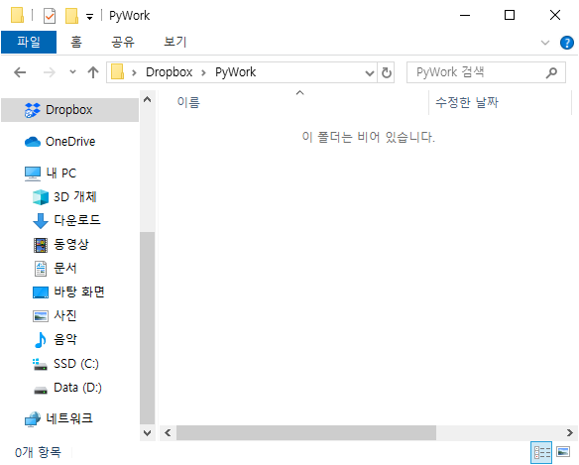
Firstly, create your work folder!
For example, I created D:\Dropbox\PyWork

Slide 14
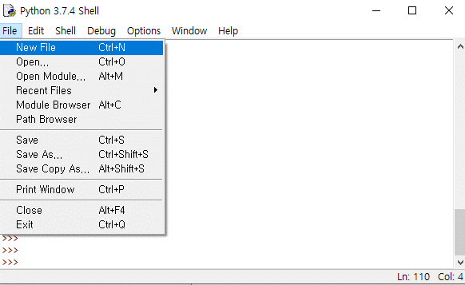
Create new file

Slide 15
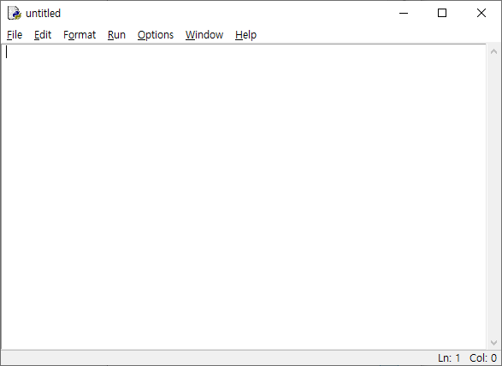

Slide 16
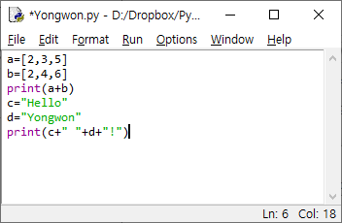
Assignment : Capture this screen!
(Page 1)
Substitute with your name!

Slide 17
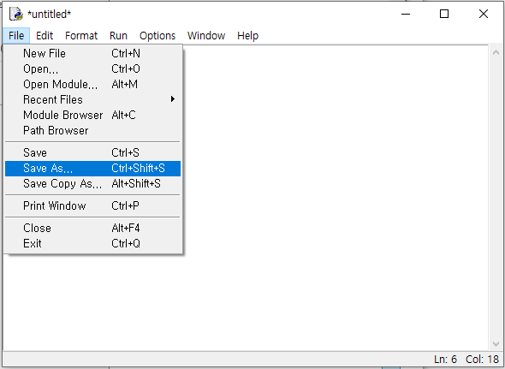

Slide 18
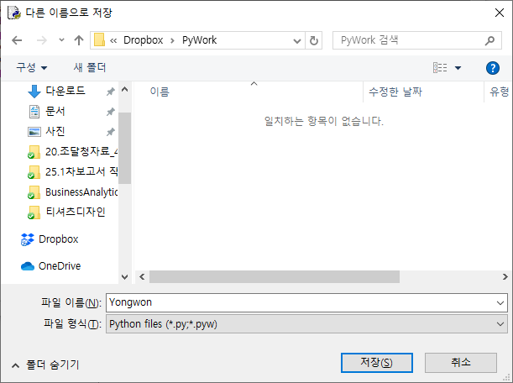
Saving program file to your work folder
Assignment : Capture this screen!
(Page 2)
Write your name here

Slide 19
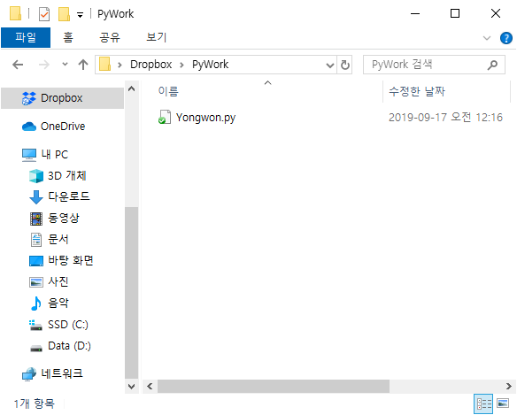
Navigate to your folder, you’ll find your program
Assignment : Capture this screen!
(Page 3)

Slide 20
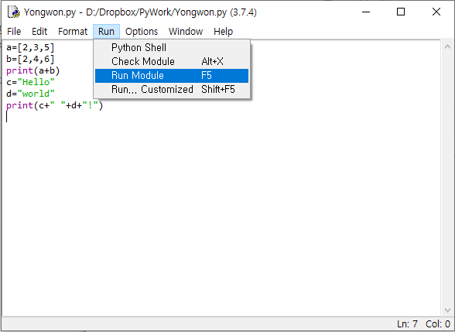
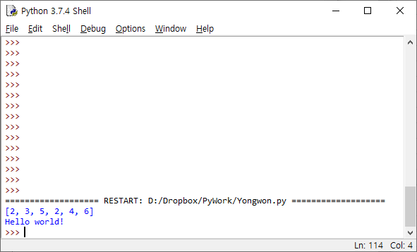
Back to shell, press F5 (or Run-Run module)
Assignment : Capture this screen!
(Page 4)

Slide 21
Assignment 1
Install python and write your first program with your name
Save the program with your name
Capture four screens, paste to powerpoint(or keynote)
First page of your document should specify your name and student ID!

